Slide 1
Computer Networks
PPT-3 Error Detection and Correction
Anand
Department of Computer Science
Keshav Mahavidyalaya

Slide 2
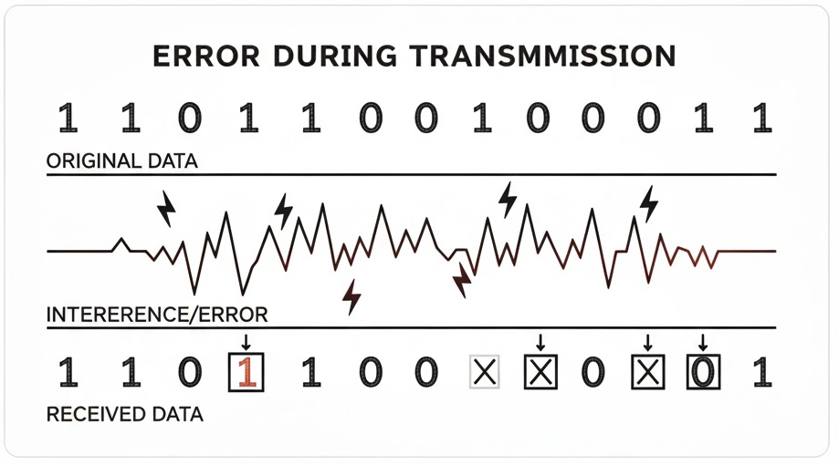
Error Detection & Correction
Error detection in computer networks is a process of identifying errors that may occur during the transmission of data between devices in a network. These errors can be caused by various factors, such as noise, interference, signal attenuation*, or hardware failures. The primary goal of error detection mechanisms is to ensure the integrity of the transmitted data and, if possible, to correct any errors that occur.
*Signal attenuation is the loss of signal strength as it travels through a medium or system

Slide 3
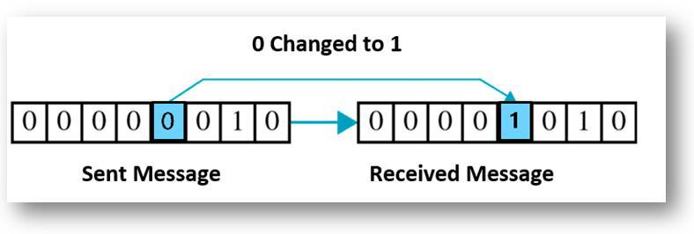
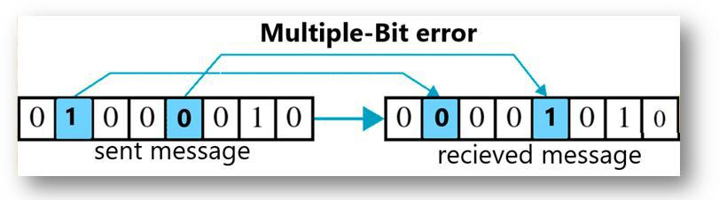
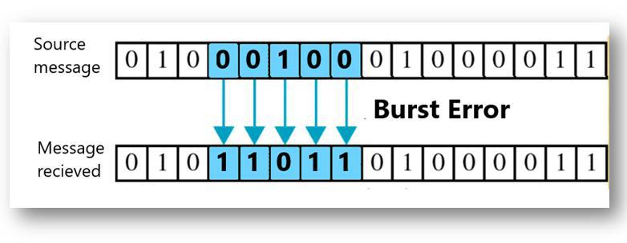
Types of Network Errors
Single Bit Error
Multiple Bit Error
Burst Error
Cable or Connection Faults
Faulty Network Interface Cards (NICs)
Router or Switch Failures
Damaged or Faulty Wireless Access Points
Power Supply Issues
Signal Interference (Wireless Networks)
Overheating of Network Devices
Broken Ports or Connectors
Hardware Incompatibility
Firmware or Hardware Configuration Issues

Slide 4
Methods for Error Detection
Parity / VRC
2d Parity /LRC
Checksum
Cyclic Redundancy Check

Slide 5
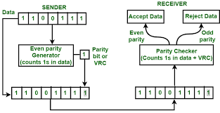
Parity /VRC
Parity can only detect single-bit errors
Parity is not effective against certain types of errors, such as burst errors, where multiple consecutive bits are corrupted

Slide 6
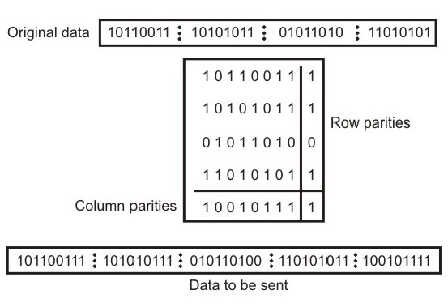
2D Parity / LRC
Two-dimensional (2D) parity is an extension of the basic parity checking concept, where parity bits are added both horizontally and vertically to a block of data.
2D parity is still primarily focused on detecting single-bit errors.
2D parity is not effective in detecting or correcting burst errors, where multiple bits in close proximity are corrupted.

Slide 7
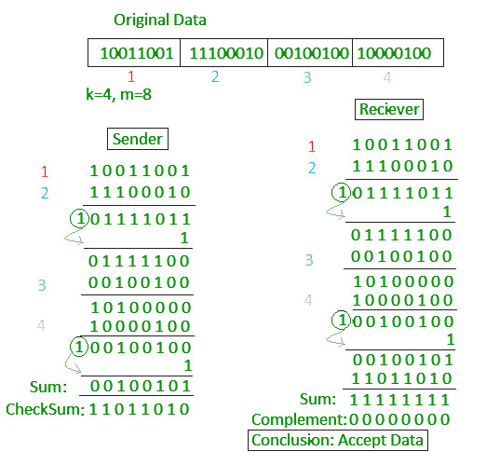
Checksum
Checksums are a form of error-checking technique commonly used in computing and data communication to detect errors in data transmission.
Checksums are not effective in detecting more sophisticated errors, such as burst errors or multiple simultaneous errors.
Many checksum algorithms require fixed-size blocks of data. If the data size varies, padding or other adjustments may be necessary, potentially leading to inefficiencies in terms of both space and computation

Slide 8
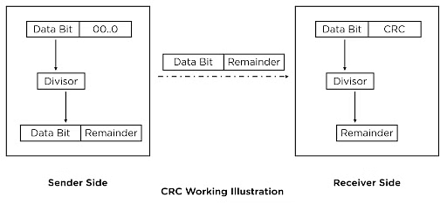
Cyclic Redundancy Check
It is a type of checksum that involves the use of polynomial codes to generate a fixed-size value (CRC code) based on the data being transmitted. This CRC code is then sent along with the data, and the receiving end uses the same polynomial code to recalculate the CRC code. If the recalculated CRC code matches the one received, the data is assumed to be free of errors; otherwise, an error is detected.

Slide 9
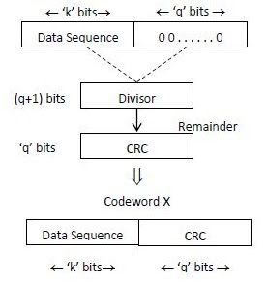
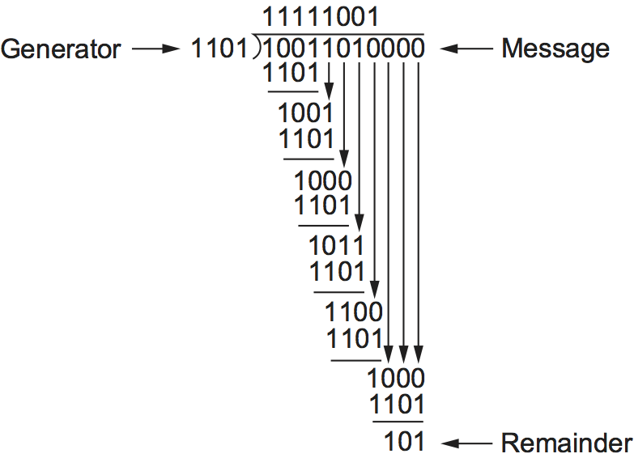
CRC Calculation using Polynomial long division

Slide 10
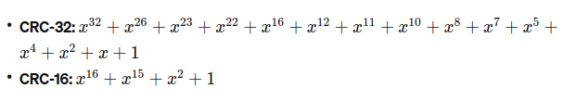
Divisor Polynomial
The selection of a divisor polynomial in Cyclic Redundancy Check (CRC) is a crucial aspect that directly influences the effectiveness of error detection.
Degree of Polynomial : The degree of the divisor polynomial should be carefully chosen based on the desired level of error detection. A higher-degree polynomial can detect a broader range of errors, including longer burst errors. However, it also results in a longer CRC code.
Odd Degree Polynomial: To ensure that the divisor polynomial can detect all single-bit errors, it is common to use a polynomial with an odd degree. An odd-degree polynomial ensures that it can detect any odd number of errors, including a single-bit error.
Performance Considerations: The computational complexity of polynomial division increases with the degree of the polynomial. Therefore, the selection of a divisor polynomial should also consider the computational efficiency, especially in systems where real-time processing is crucial.

Slide 11
Hamming Code - Error Correction
In this technique, additional parity bits are added to the message, allowing the receiver to detect and correct single-bit and multiple-bit errors.
Example: Suppose the sender wants to transmit the message whose bit representation is ‘1011001’
Total number of bits (d) = 7
Total number of redundant parity bits (p) = 4
Thus, total bits (d+p) = 7 + 4 = 11
For computing the total number of redundant bits: 2^{p} ≥ d+p+1 DATA + REDUNDANT BITS
CODE WORD

Slide 12
1: Parity Bits Addition
Parity bits are inserted at positions that are powers of 2
- | - | - | 2³ | - | - | - | 2² | - | 2¹ | 2⁰ | Power of 2
1 | 0 | 1 | P8 | 1 | 0 | 0 | P4 | 1 | P2 | P1 | Message (bit sequence)
11 | 10 | 9 | 8 | 7 | 6 | 5 | 4 | 3 | 2 | 1 | Total bits (d+p)

Slide 13
2: Calculating Parity Bits
Position | P8 | P4 | P2 | P1
0 | 0 | 0 | 0 | 0
1 | 0 | 0 | 0 | 1
2 | 0 | 0 | 1 | 0
3 | 0 | 0 | 1 | 1
4 | 0 | 1 | 0 | 0
5 | 0 | 1 | 0 | 1
6 | 0 | 1 | 1 | 0
7 | 0 | 1 | 1 | 1
8 | 1 | 0 | 0 | 0
9 | 1 | 0 | 0 | 1
10 | 1 | 0 | 1 | 0
11 | 1 | 0 | 1 | 1
Each parity bit checks a specific set of bits in the data word, including other parity bits. The parity bits are set such that the number of 1s in the positions they check (including the parity bit itself) is even or odd, depending on the chosen parity scheme (usually even parity).
For example, parity bit 1 checks bits 1, 3, 5, 7, etc., parity bit 2 checks bits 2, 3, 6, 7, etc., and so on.

Slide 14
3: Error Detection
11 | 10 | 9 | 8 | 7 | 6 | 5 | 4 | 3 | 2 | 1 | Bit Position
D7 | D6 | D5 | P8 | D4 | D3 | D2 | P4 | D1 | P2 | P1 | Hamming Code Pattern
1 | 0 | 1 |  | 1 | 0 | 0 |  | 1 |  |  | Original Data to be sent
0
1
1
0
P1 : 3, 5, 7, 9, 11 P2 : 3, 6, 7, 10, 11 P4 : 5, 6, 7 P8 : 9, 10, 11

Slide 15
3: Error Detection
11 | 10 | 9 | 8 | 7 | 6 | 5 | 4 | 3 | 2 | 1 | Bit Position
D7 | D6 | D5 | P8 | D4 | D3 | D2 | P4 | D1 | P2 | P1 | Hamming Code Pattern
1 | 0 | 1 | 0 | 1 | 0 | 0 | 1 | 1 | 1 | 0 | Original Data to be sent
1 | 0 | 0 | 0 | 1 | 0 | 0 | 1 | 1 | 1 | 0 | Transmitted data with error
P1 : 3, 5, 7, 9, 11 P2 : 3, 6, 7, 10, 11 P4 : 5, 6, 7 P8 : 9, 10, 11

Slide 16
4: Error Correction
Bit Position | 11 | 10 | 9 | P8 8 | 7 | 6 | 5 | P4 4 | 3 | P2 2 | P1 1
Data Received | 1 | 0 | 0 | 0 | 1 | 0 | 0 | 1 | 1 | 1 | 0
3,5,7,9,11 | P1 | 1
3,6,7,10,11 | P2 | 1
5,6,7 | P4 | 1
9,10,11 | P8 | 1

Slide 17
Hamming Weight
The Hamming weight of a codeword is equal to the number of non-zero elements in the codeword.
Hamming weight of a codeword c is denoted by w(c).
w(0100)=1 and w(1111)=4

Slide 18
Hamming Distance
Hamming distance between two codewords is the number of places by which the codewords differ. For two codes c1 and c2, the hamming distance is denoted as d(c1 ,c2)
E.g.: c1 ⊕ c2 ⇒ 0100 ⊕ 1111 ⇒ 1011. The XOR operator gives result 3 as there are three 1s obtained after XORing of 0s and 1s.

Slide 19
Min. Hamming Distance
For two codewords of same length, it is define as the minimum or smallest hamming distance between the two codewords. It is calculated by counting the number of positions in which the corresponding symbols are different. It is denoted by d* or dmin.
E.g.: consider four codewords as: c1=010, c2=011, c3=111, c4=101. The hamming distance between codewords is:

Slide 20
Min. Hamming Distance c1=010, c2=011, c3=111, c4=101.
010 ⊕ 011 = 001, d(010, 011) = 1
010 ⊕ 111 = 101, d(010, 111) = 2
010 ⊕ 101 = 111, d(010, 101) = 3
011 ⊕ 111 = 100, d(011, 111) = 1
011 ⊕ 101 = 110, d(011, 101) = 2
111 ⊕ 101 = 010, d(111, 101) = 1

Slide 21
4 BIT | HAMMING CODE | WEIGHT
0000 | 0000000 | 0
0001 | 0000111 | 3
0010 | 0011001 | 3
0011 | 0011110 | 4
0100 | 0101010 | 3
0101 | 0101101 | 4
0110 | 0110011 | 4
0111 | 0110100 | 3
1000 | 1001011 | 4
1001 | 1001100 | 3
1010 | 1010010 | 3
1011 | 1010101 | 4
1100 | 1100001 | 3
1101 | 1100110 | 4
1110 | 1111000 | 3
1111 | 1111111 | 7
Smallest non-zero weight = 3
Therefore:
min. hamming distance d_{min} = 3
SO, FOR WHOLE CODEWORD
Maximum detectable errors = d_{min} − 1 2 bit
Maximum correctable errors = (d_{min} − 1) / 2 1 bit

Slide 22

Example / Test
DATA : 1111
Codeword : 1111111
Error during Tx : 1111100
Calculate answer ?
Parity-check matrix H
P1
P2
P4
1 2 3 4 5 6 7
AFFECTED BIT POSITION

Slide 23
Single Error Correction - Double Error Detection (SEC-DED)
HAMMING CODE (SEC-DED) LOGIC
============================================================
SYNDROME | GLOBAL PARITY | RESULT | ACTION
---------|---------------|------------------|---------------
000 | Even (Valid) | No Errors | Accept Data
Not 000 | Odd (Invalid) | Single Bit Error | Correct Bit S
Not 000 | Even (Valid) | Double Bit Error | REJECT DATA
000 | Odd (Invalid) | P-bit Error | Fix P-bit
============================================================
EXAMPLE (1111100 1)
------------------------------------------------------------
1. Syndrome Check: Result is 011 (Points to Bit 3)
2. Global Check: Result is Even (Parity looks "Correct")
3. LOGIC: Non-Zero Syndrome + Even Parity
4. CONCLUSION: Double Bit Error Detected (Cannot Fix)
------------------------------------------------------------

Slide 24

Next Lecture: OSI Model

